Slide 1


Slide 2
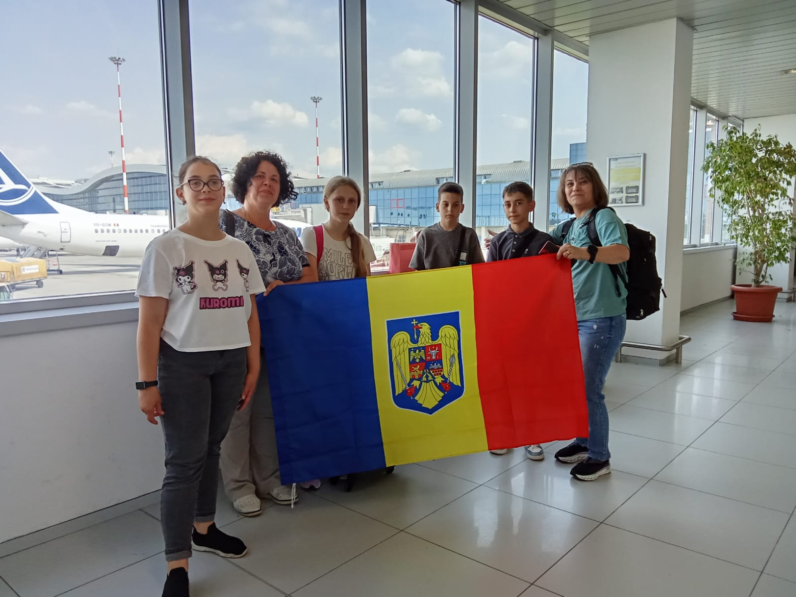
DAY 1
AT THE AIRPORT
PACKED AND READY
TO GO!
THE PICTURE WITH THE ROMANIAN FLAG IS NOT TO BE MISSED AND WE ALL WERE SMILING AND LOOKING FORWARD TO GETTING ON THE PLANE AND START THE ADVENTURE.!

Slide 3
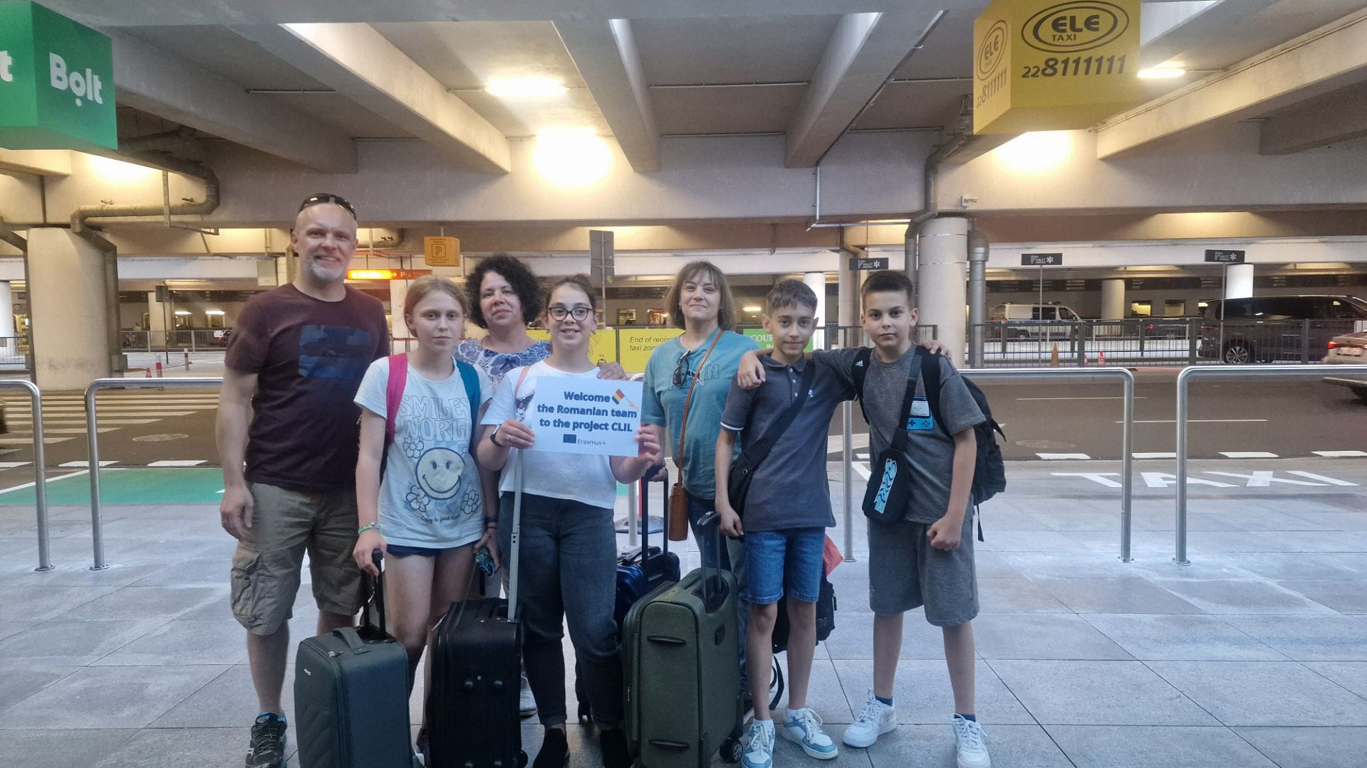
LATER IN Warsaw with Michael and his father Lucas- they were there waiting for us– the very image of the warm polish hospitality

Slide 4
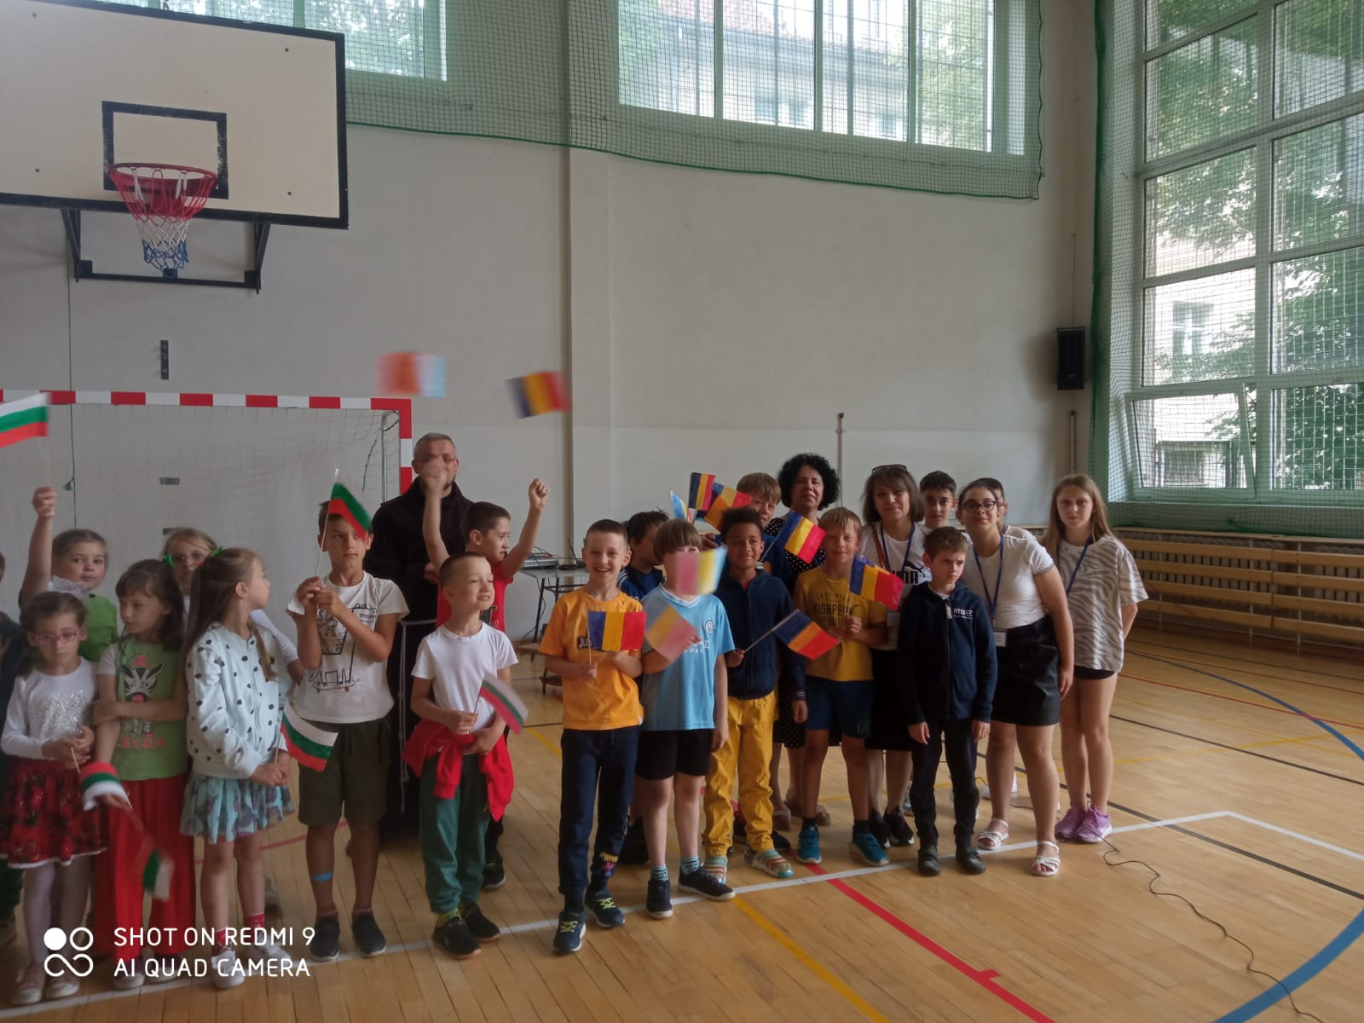
FIRST DAY IN OLSZTYN
THE SCHOOL LOOKS GREAT BUT WHAT IS OF MORE IMPORT ARE THE PEOPLE.
THE WELCOMING FESTIVITY WAS GREAT! AND IN SPITE OF THE MUCH TALKING OF THE ADULTS THE REAL PROTAGONISTS WERE THE CHILDREN! AND IF A PICTURE VALUES 1000 WORDS, THEN LET THE PICURES TALK FOR US.

Slide 5
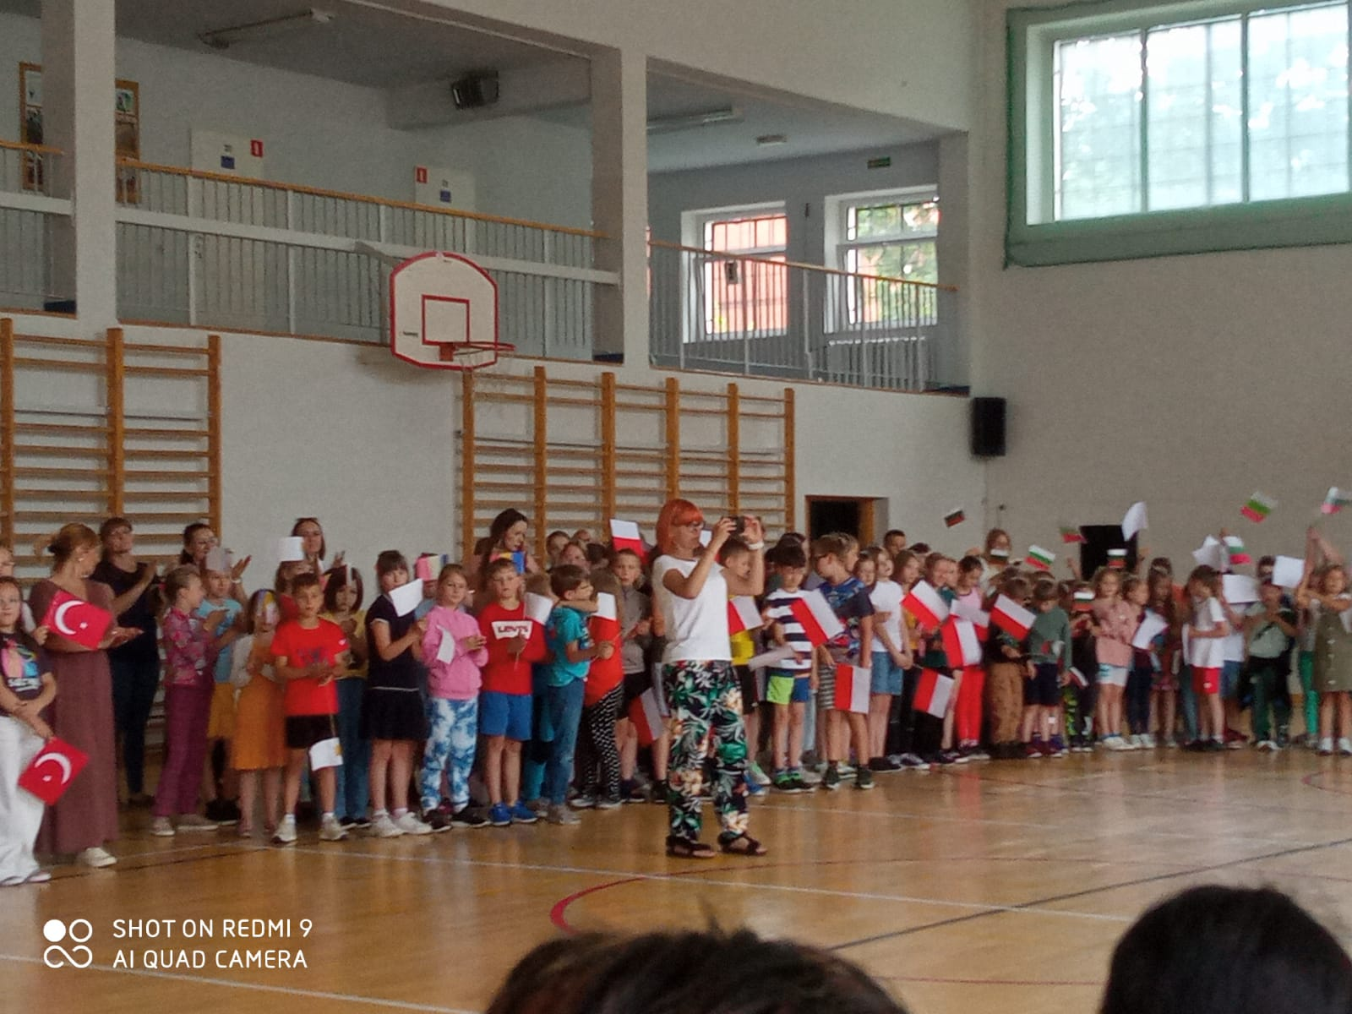
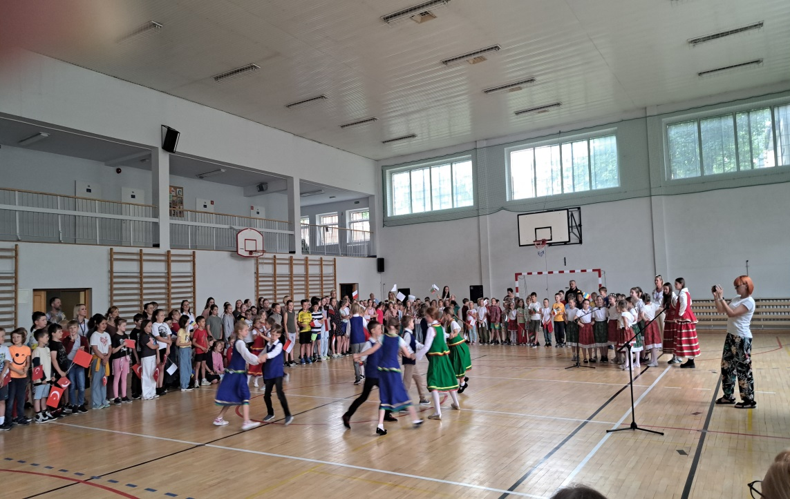
LET’S REJOYCE IN BEING DIFFERENT! DIVERSITY MAKES THINGS INTERESTING!

Slide 6
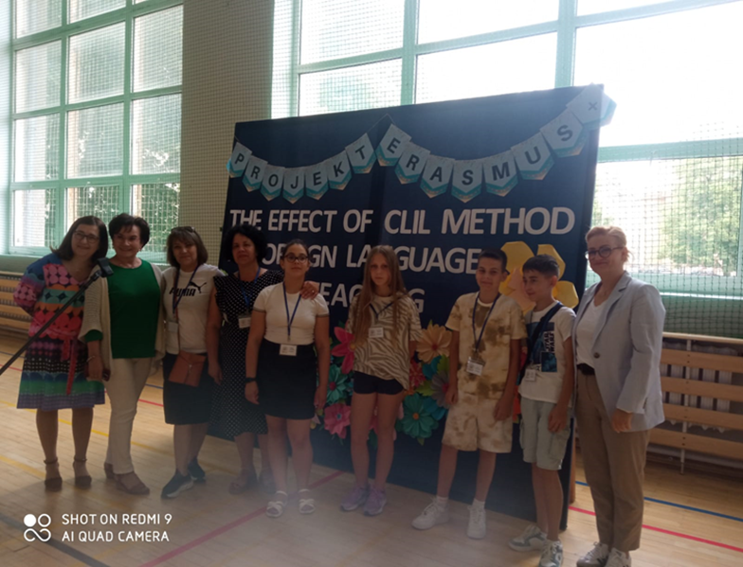
We wanted to remember –so a picture with front of the project poster was taken while visiting the school

Slide 7
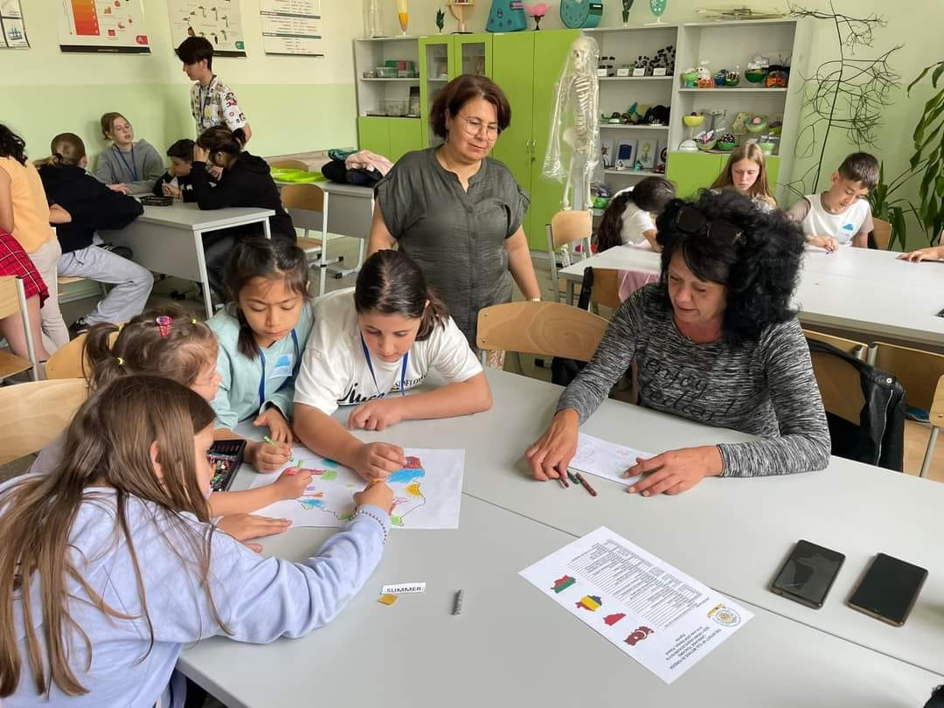
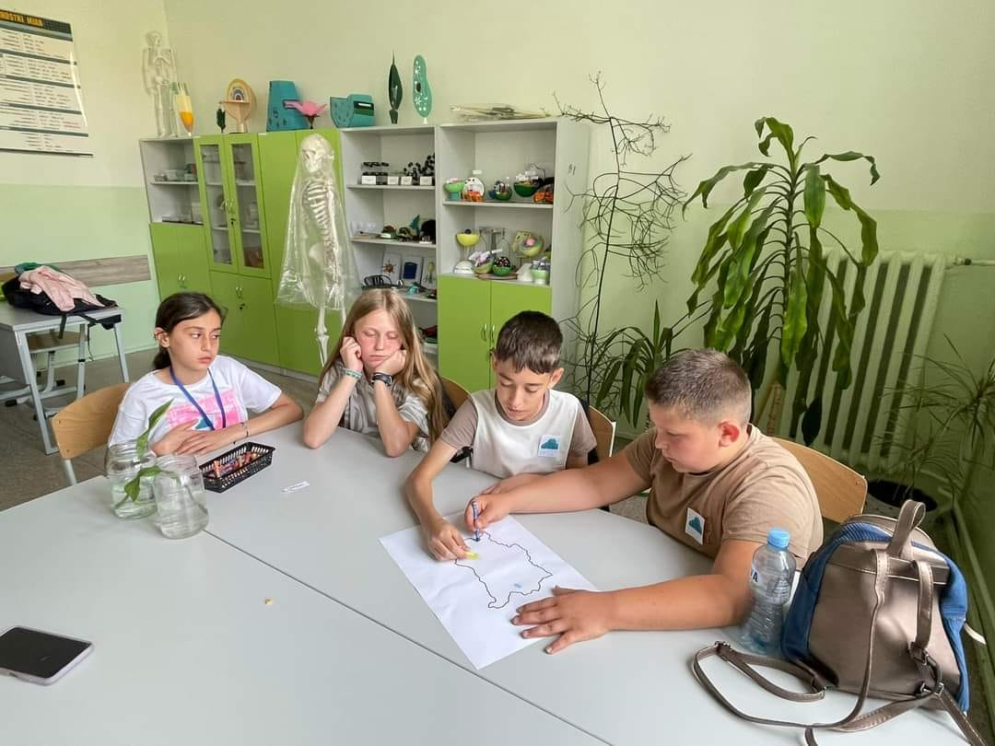
THE FOLLOWING DAYS PASS IN A BLUR OF OVERWHELMING AND ENJOYABLE ACTIVITIES
Working is fun when you share the burden . The language you speak is no barrier.
Friendship knows no borders,

Slide 8
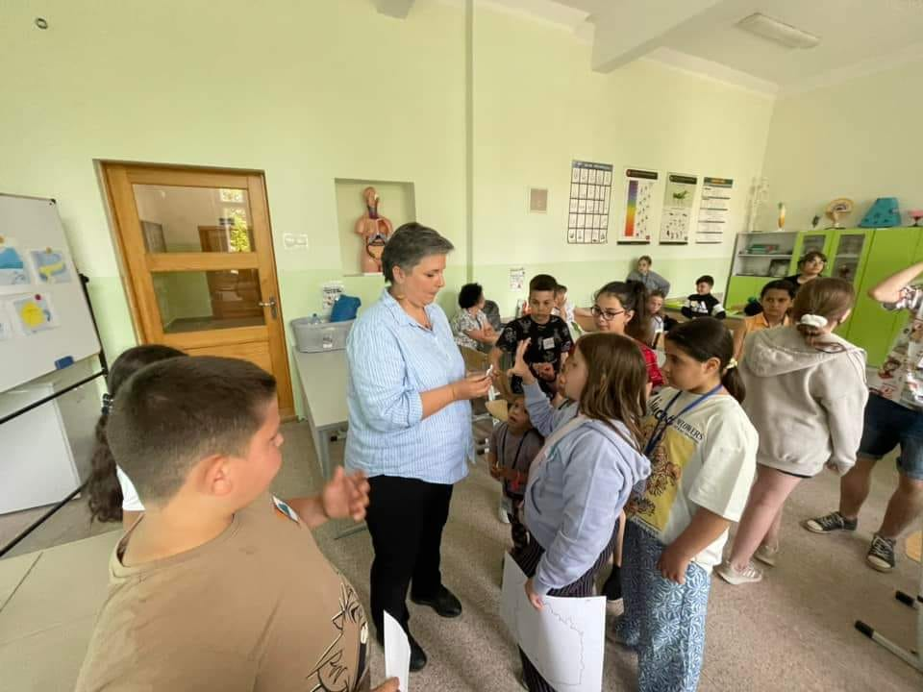
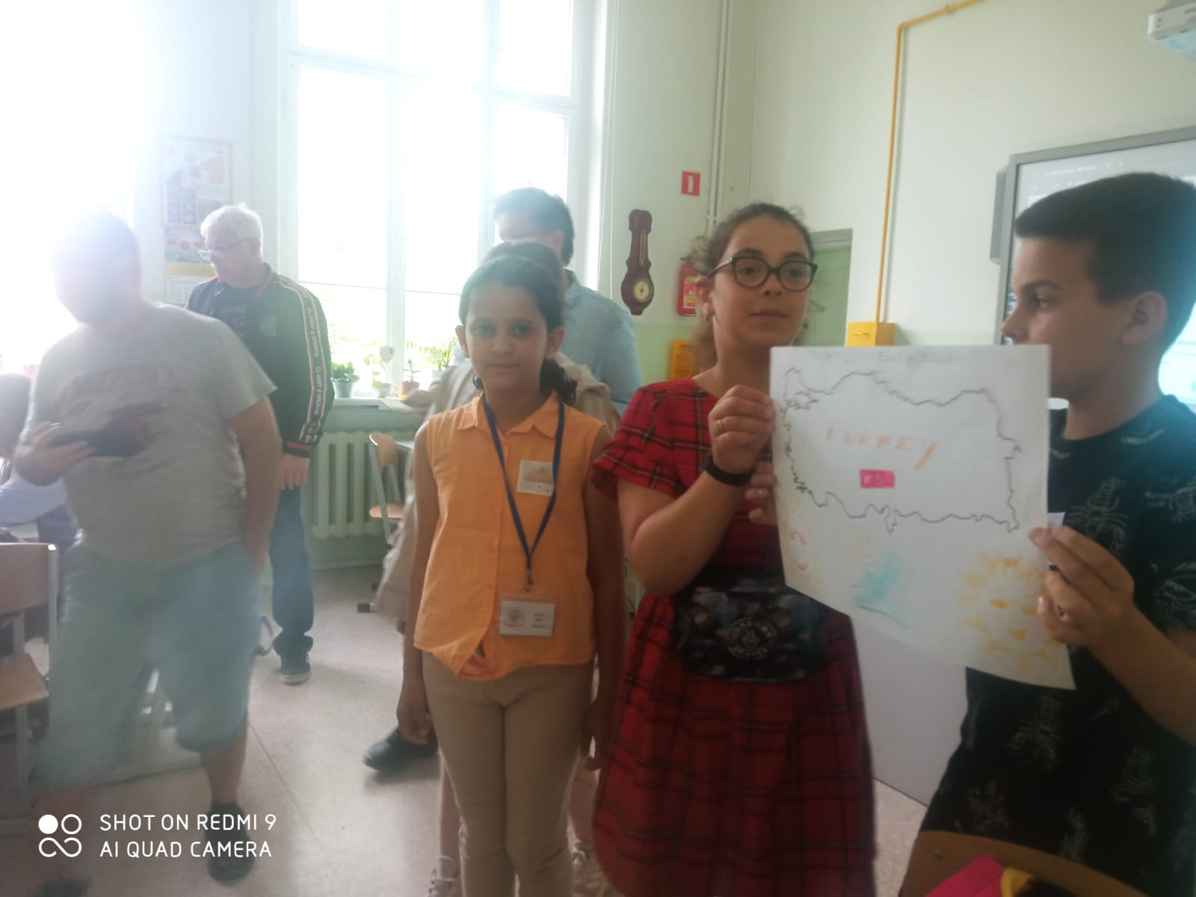
indoors learn, share and have fun

Slide 9
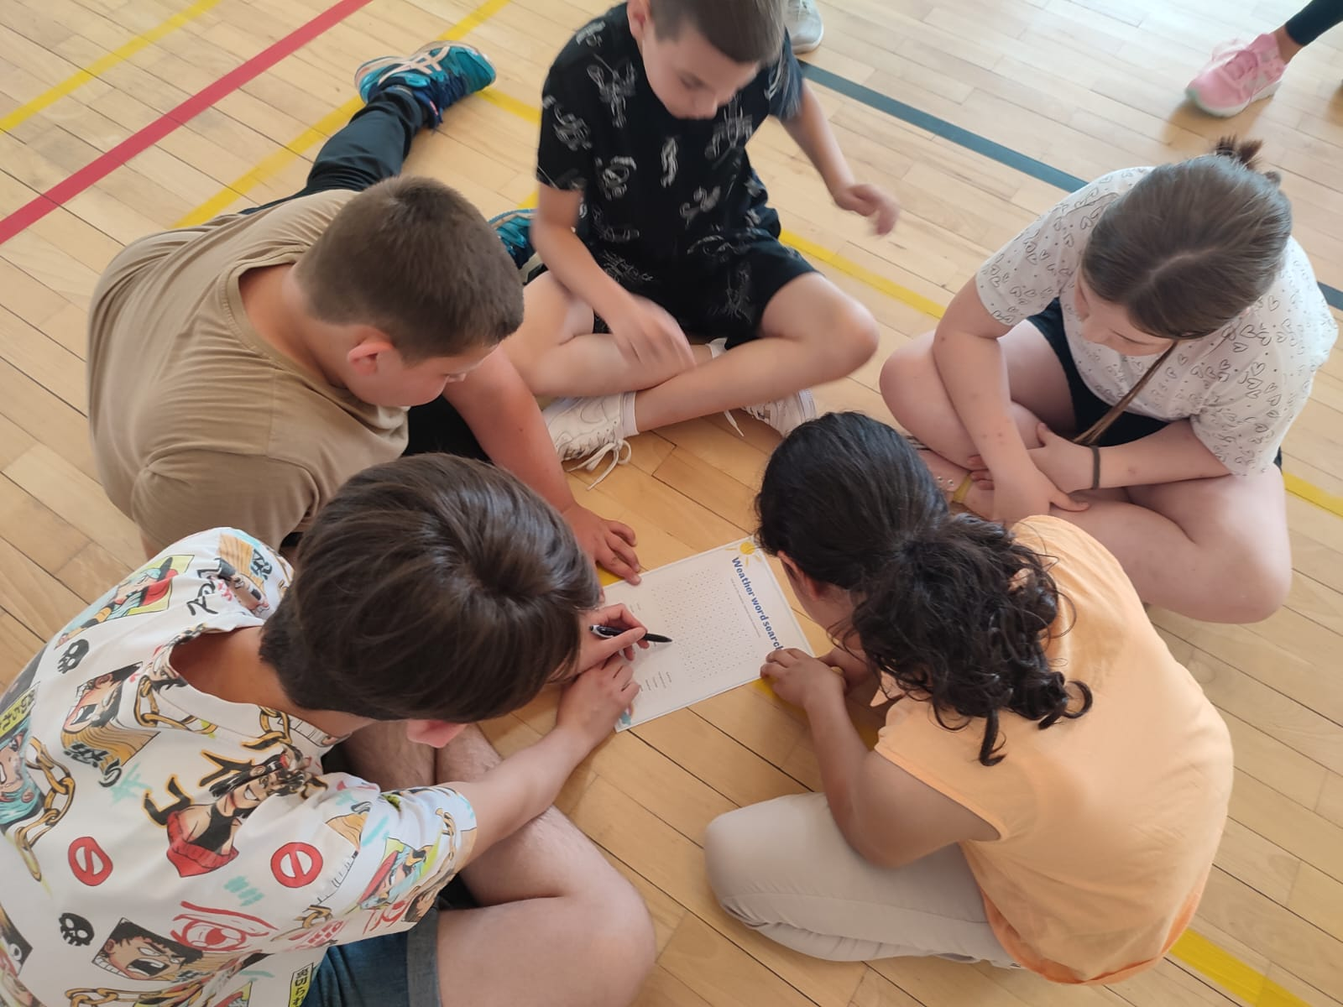
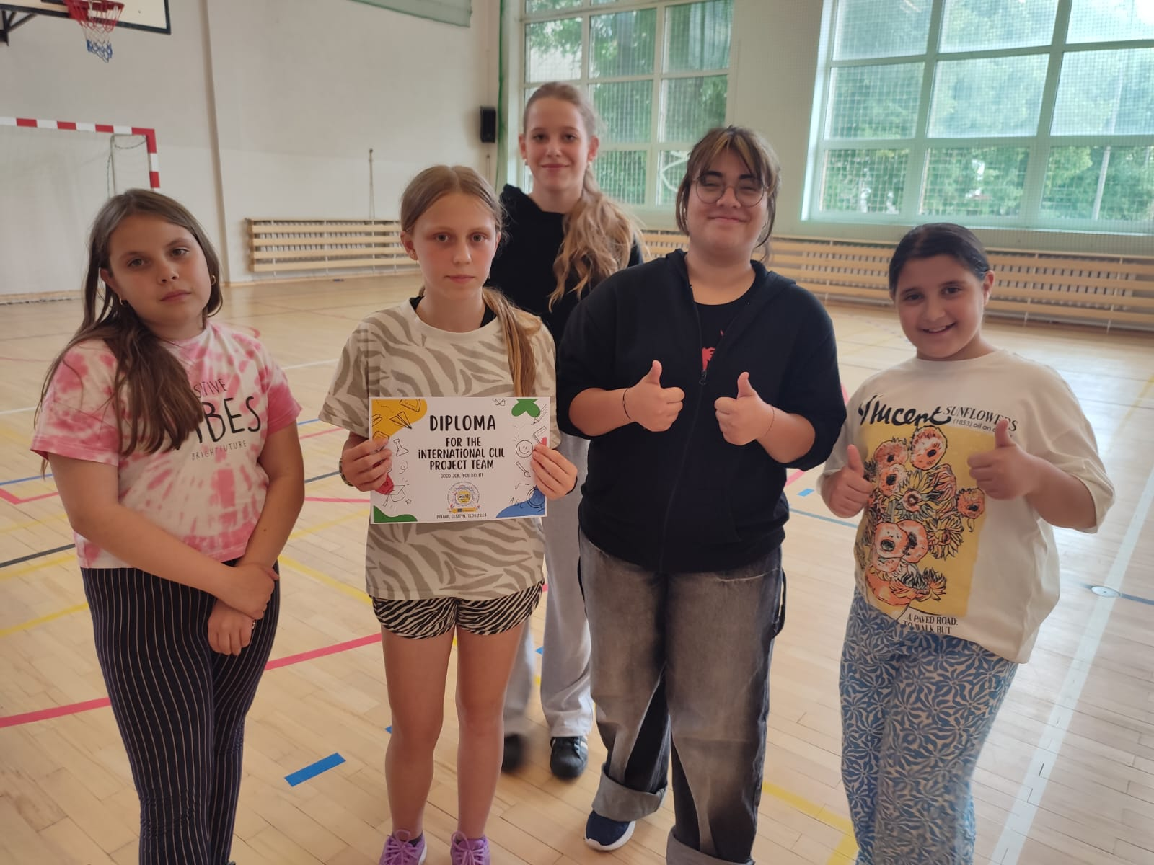
& OUTDOORS - LEARN, SHARE AND HAVE FUN

Slide 10
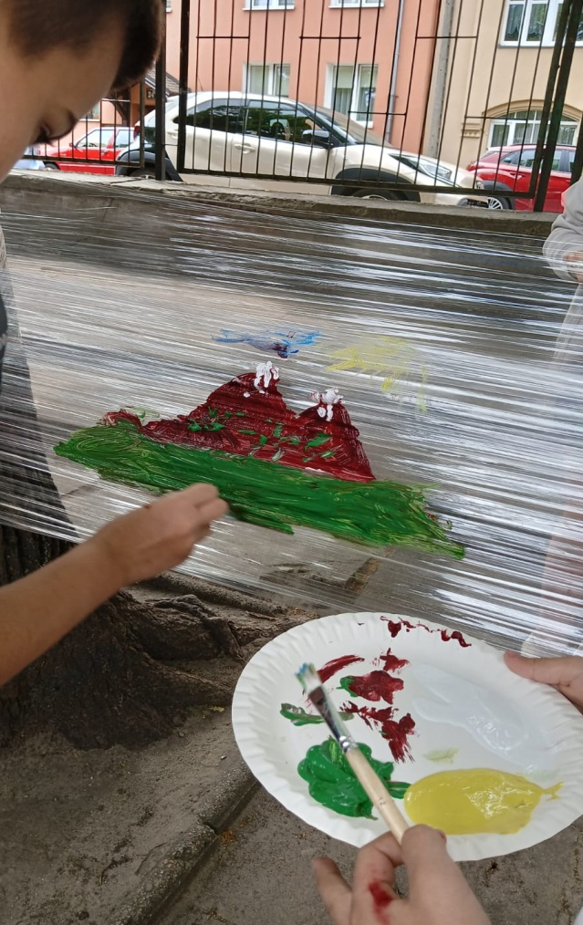
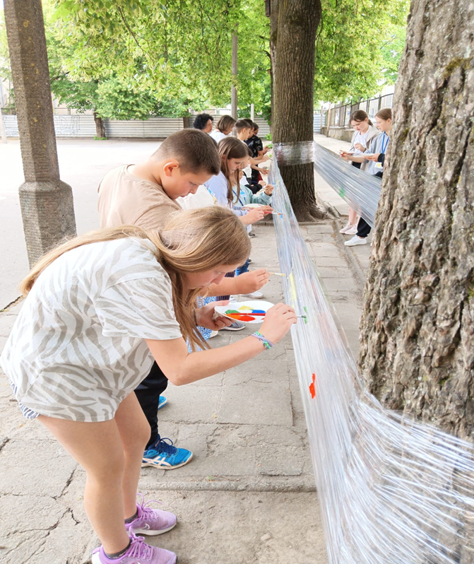
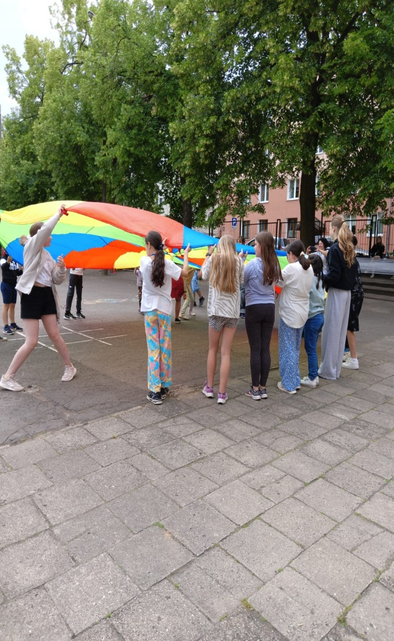

Slide 11
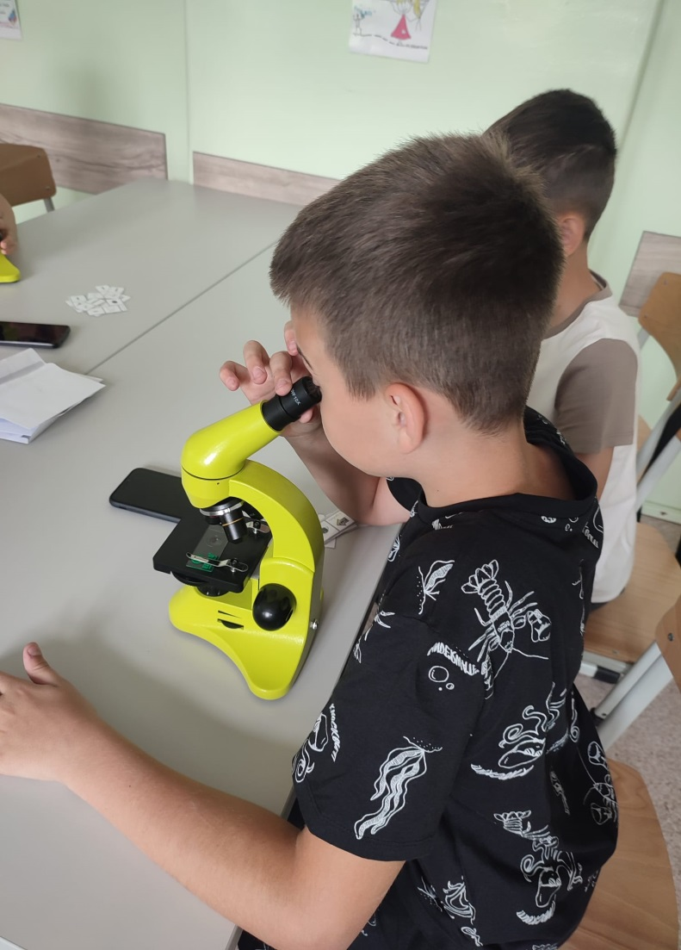
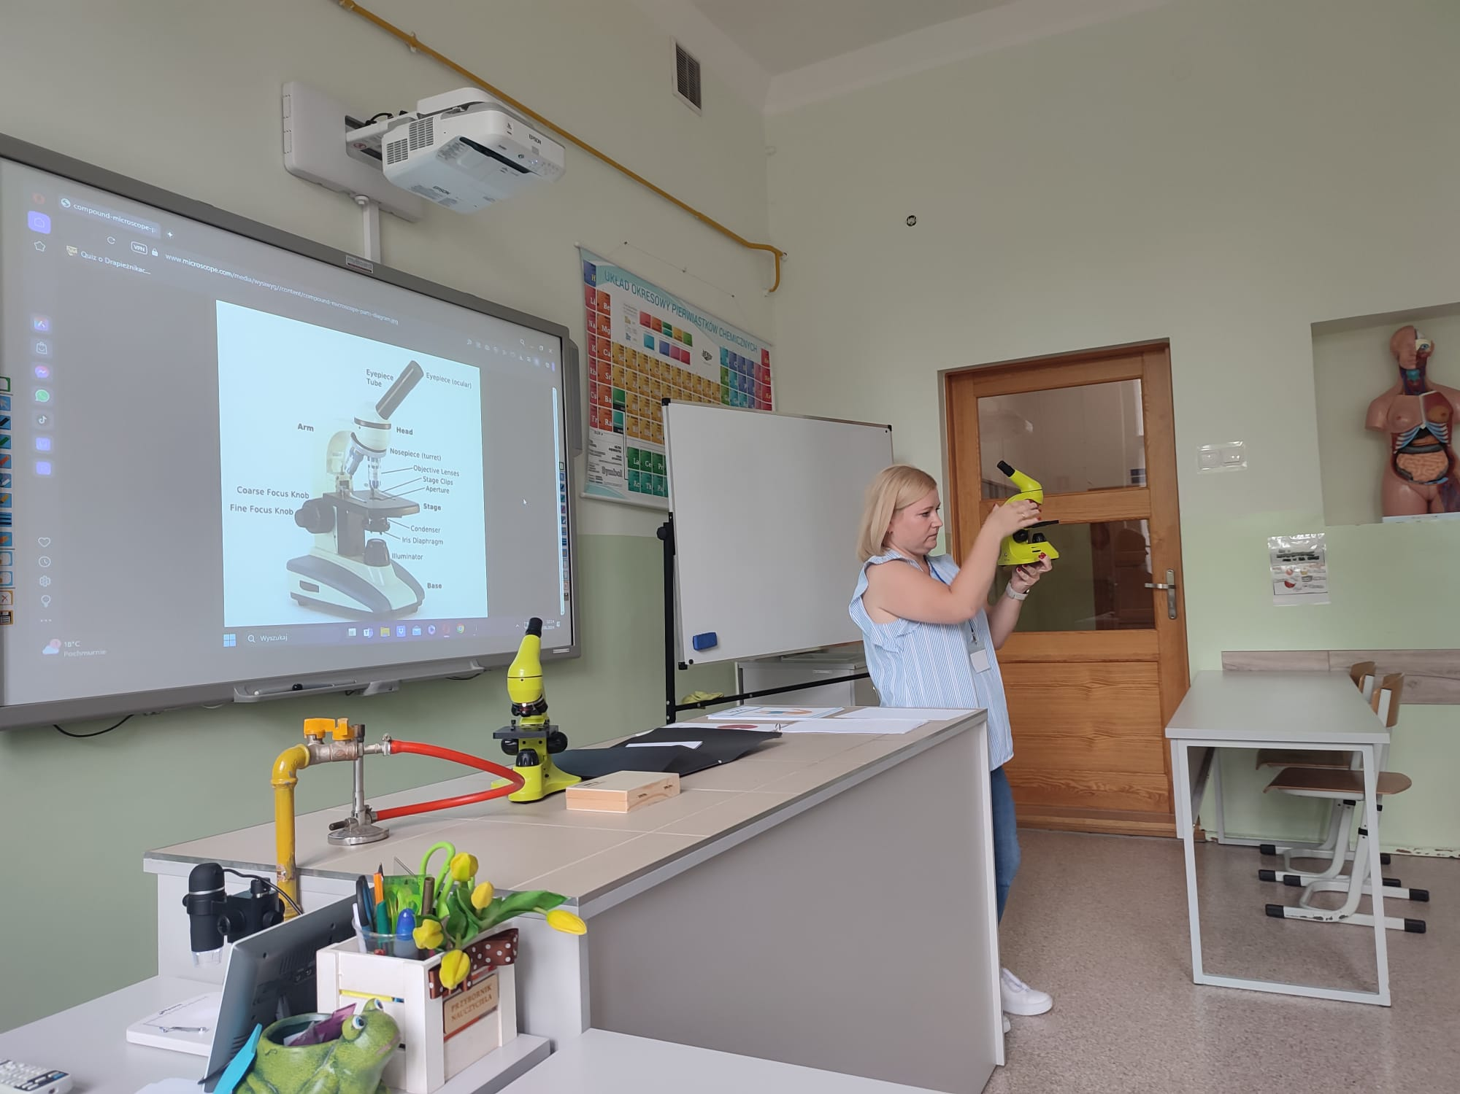
LEARN
SHARE & HAVE FUN

Slide 12
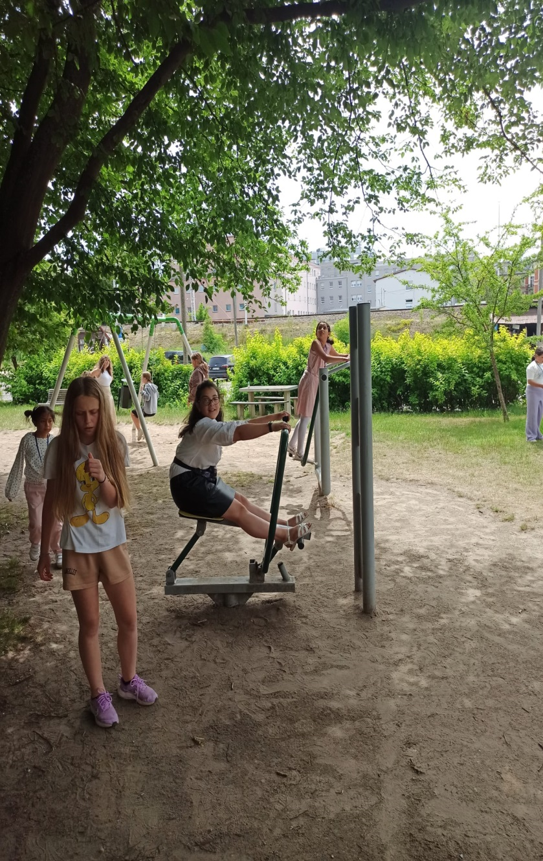
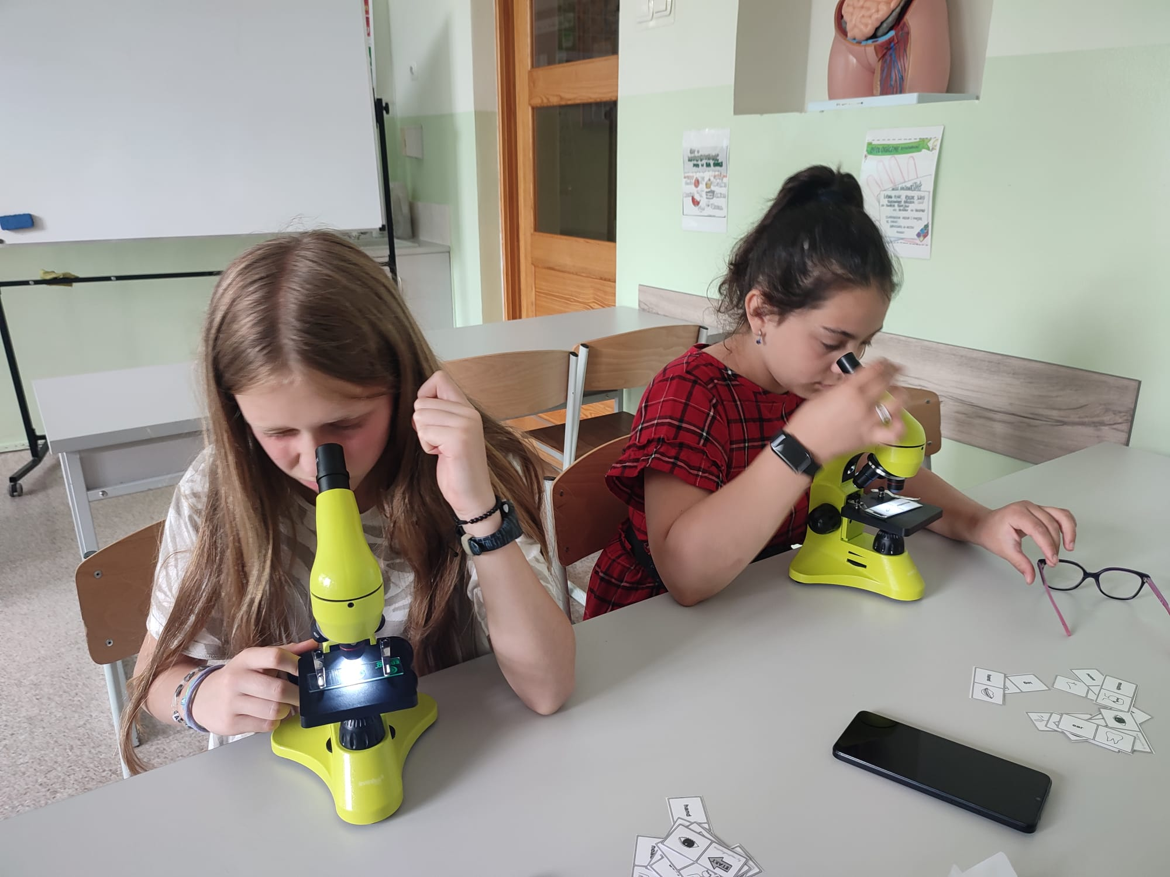

Slide 13
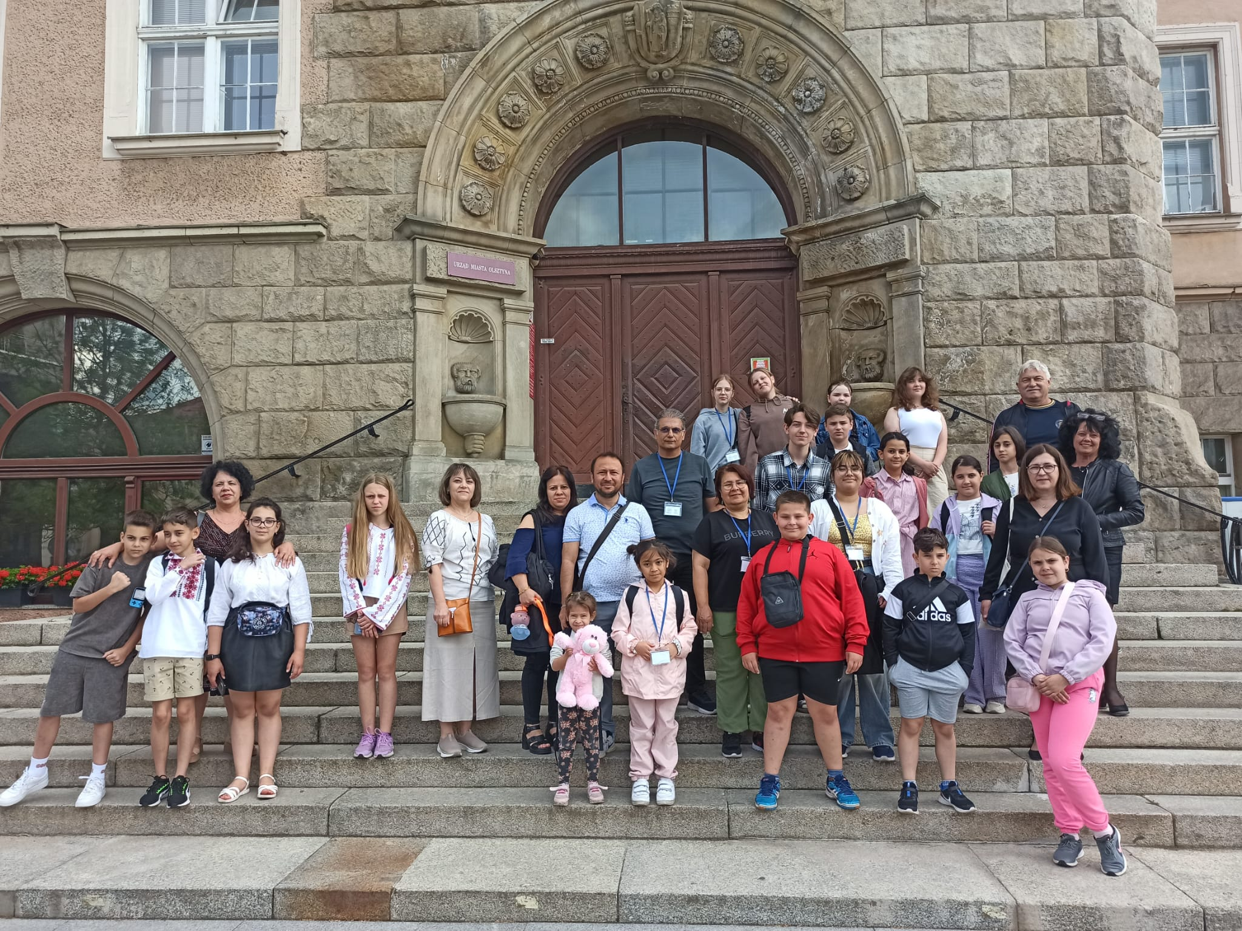

Slide 14
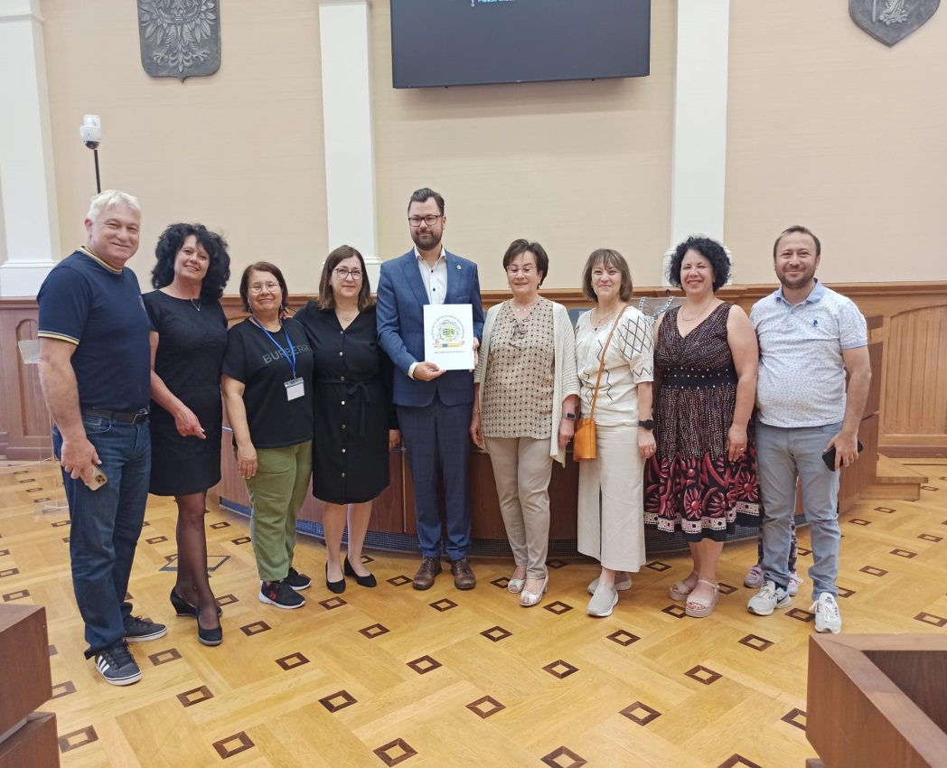
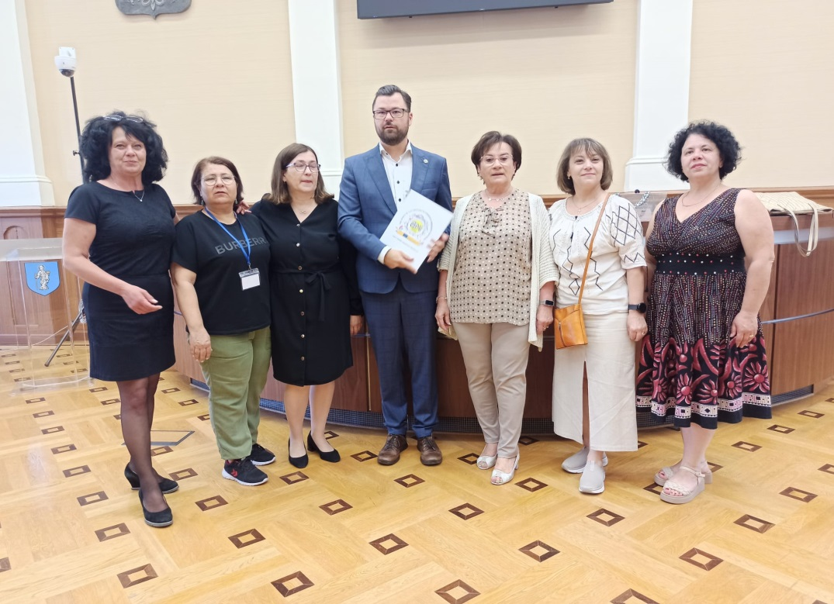
MEETING THE LOCAL AUTHORITIES

Slide 15
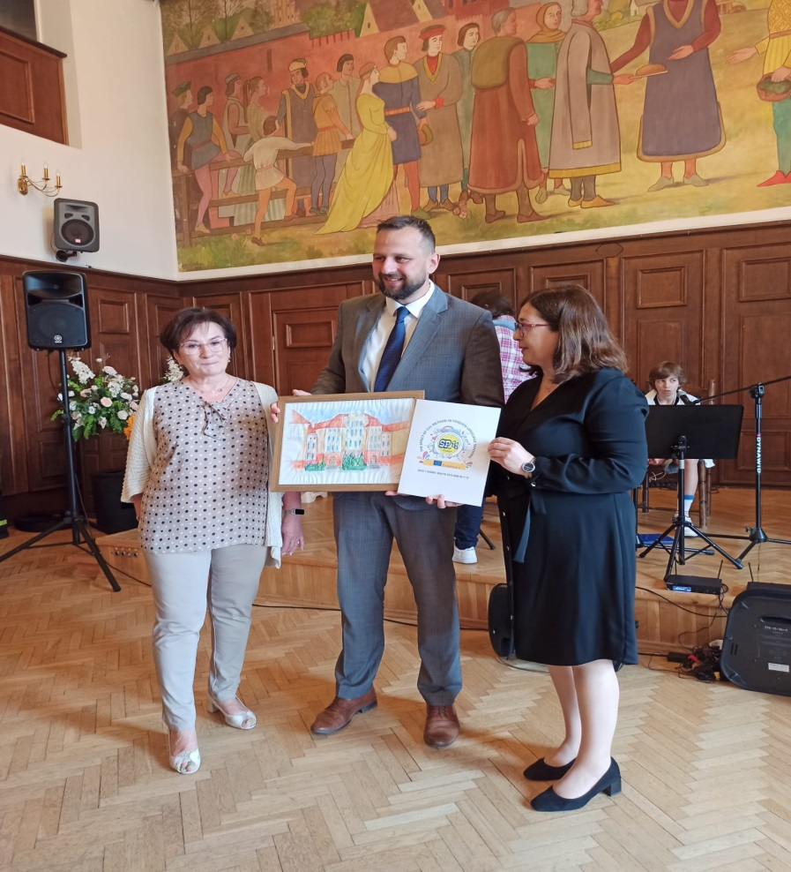
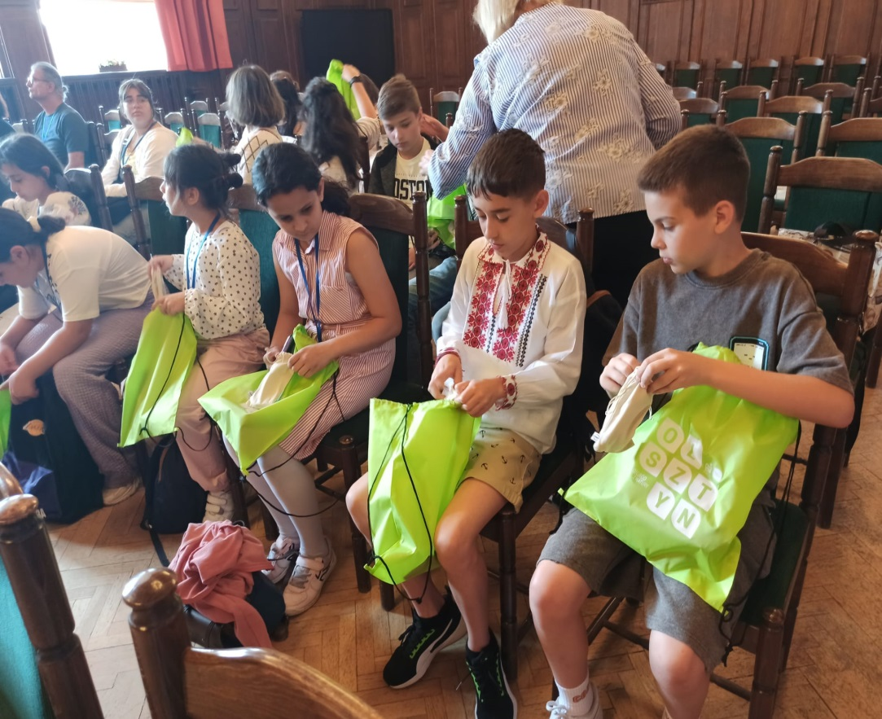
PRESENTS ARE A SIGN OF
MUTUAL APPRECIATION

Slide 16
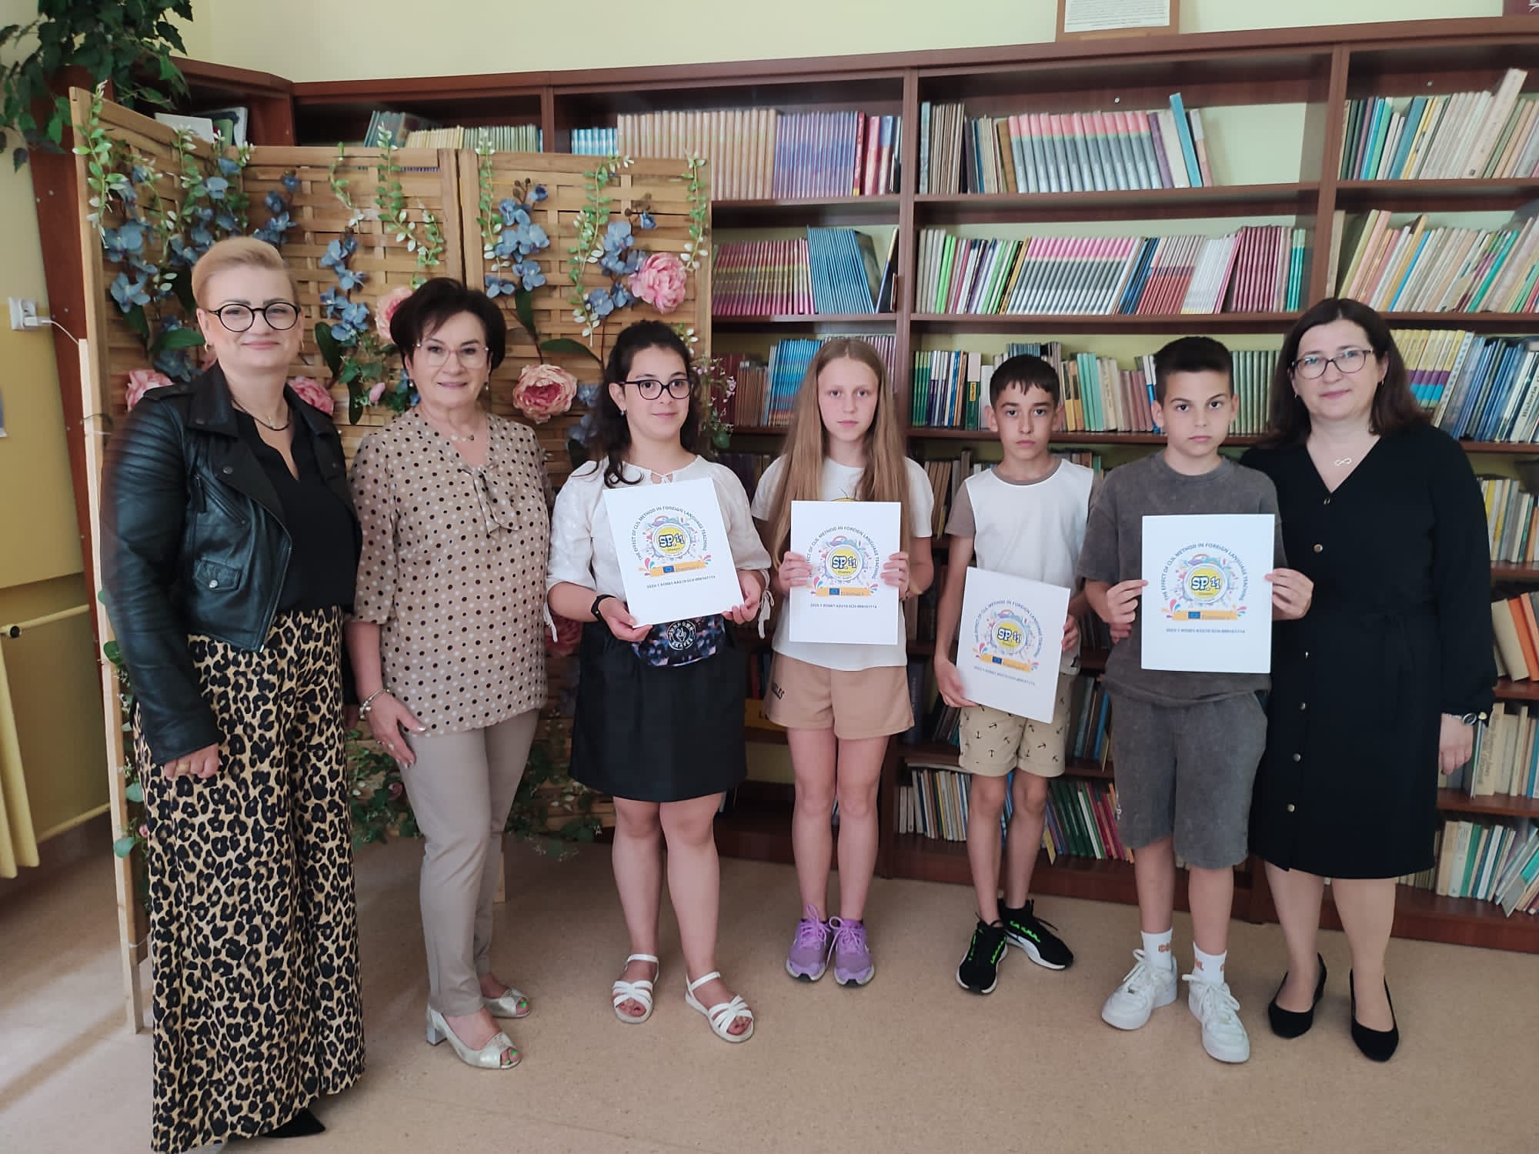
ALL GOOD THINGS COME TO AN END

Slide 17
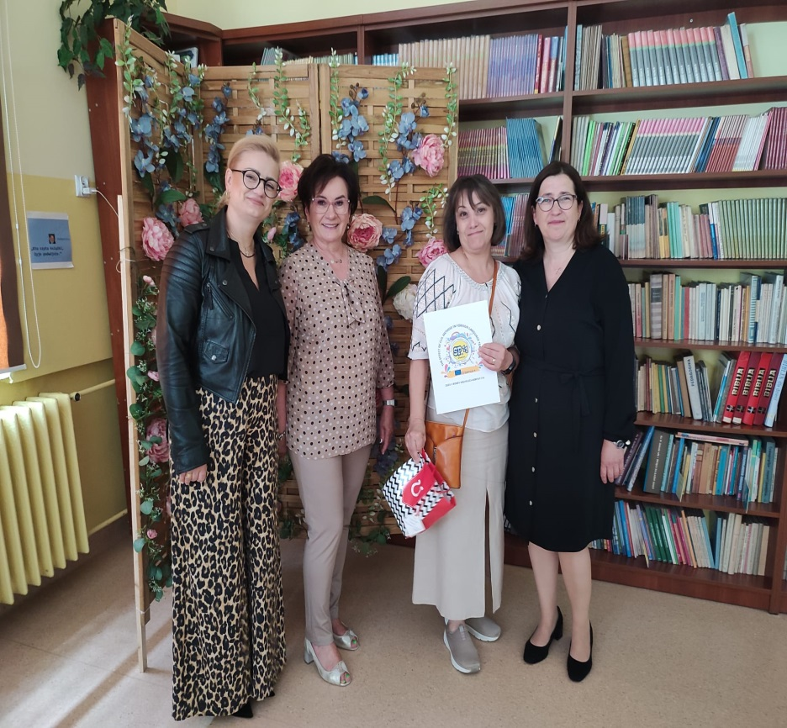
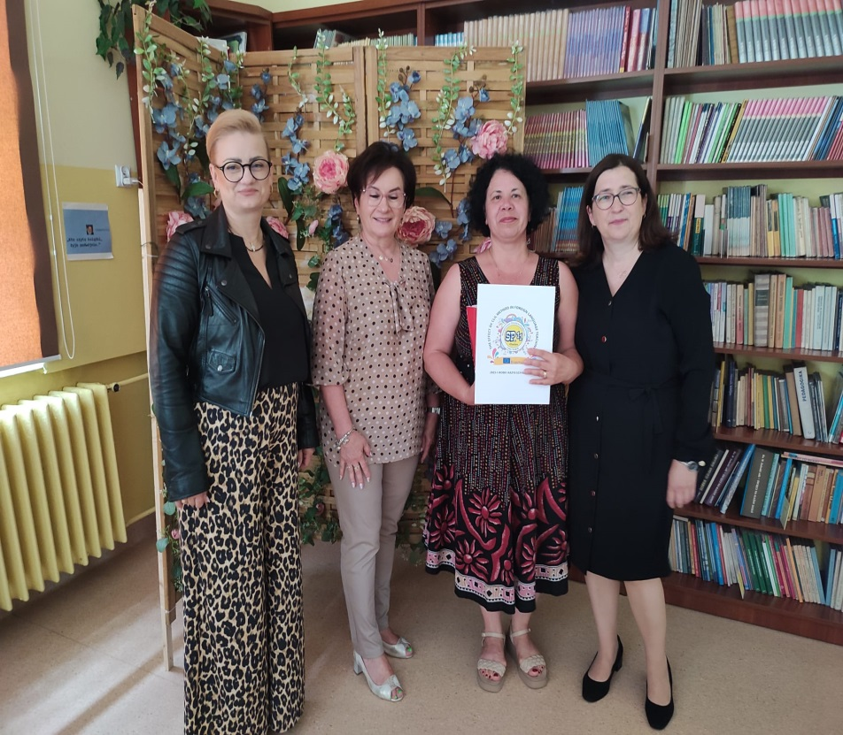
ALL GOOD THINGS COME TO AN END

Slide 18
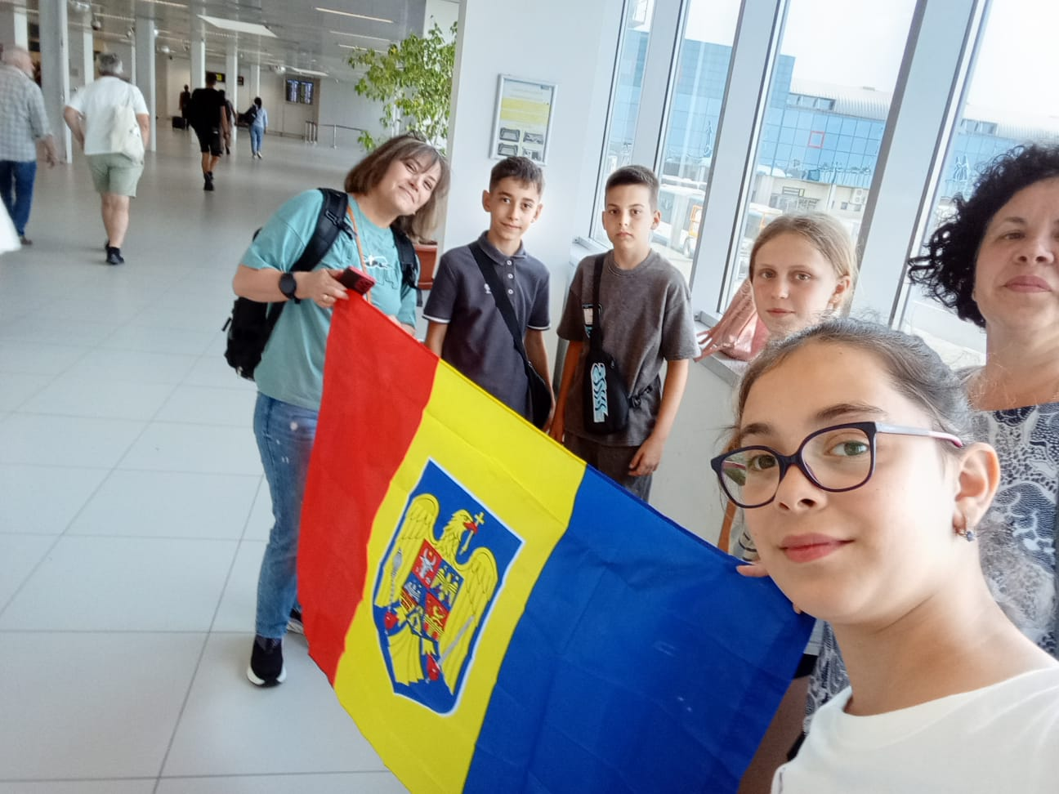
LOOKING FORWARD TO
MEETING AGAIN IN
ROMANIA

